Slide 1
Introduction to Machine Learning
INTRODUCTION TO DEEP LEARNING
Andreu Arderiu
NORTHIN SUMMER SCHOOL
Barcelona, July 2023

Slide 2
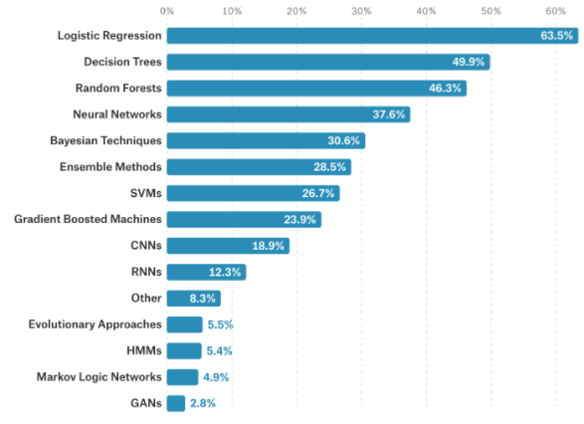
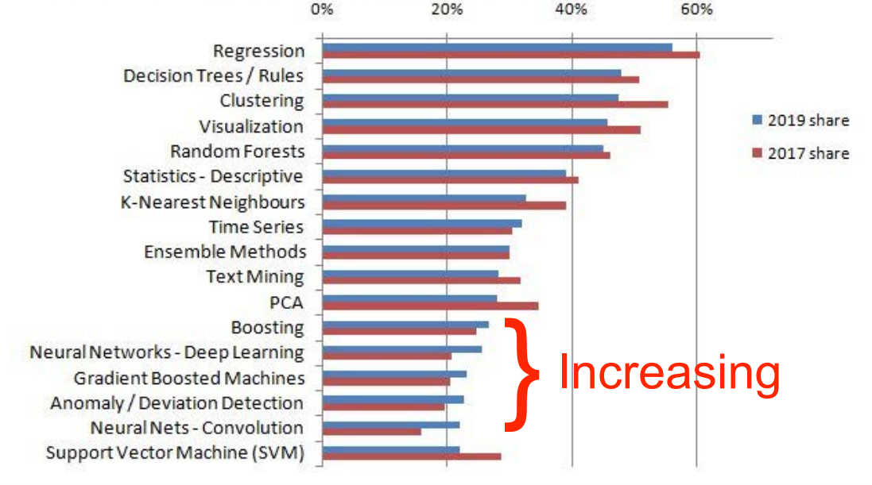
The use of Machine Learning
Kaggle’s 2017 survey Kdnuggets 2018/9 vs 2017 survey

Slide 3
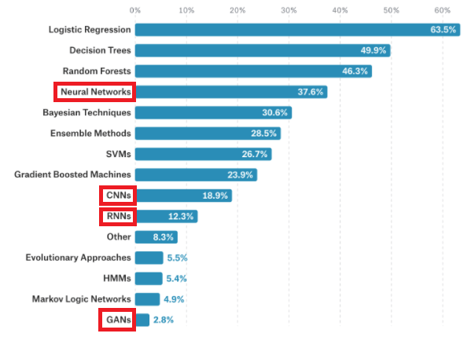
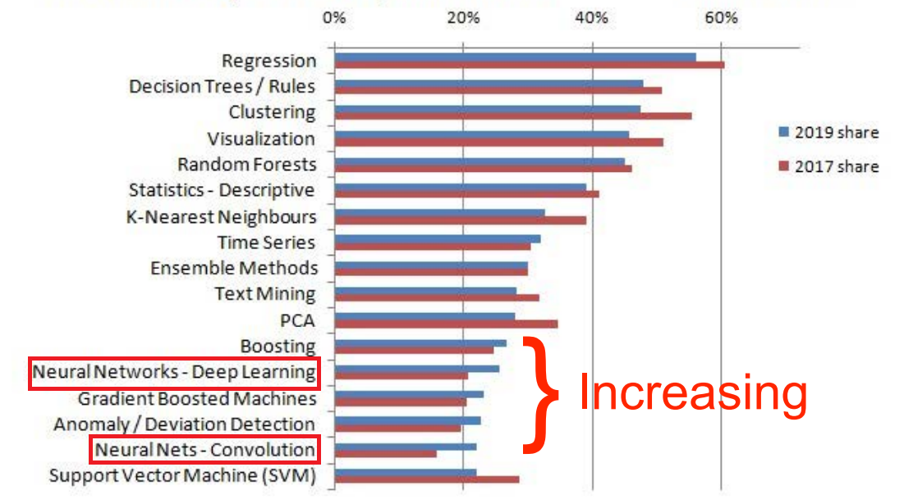
The use of Machine Learning
Kaggle’s 2017 survey Kdnuggets 2018/9 vs 2017 survey

Slide 4
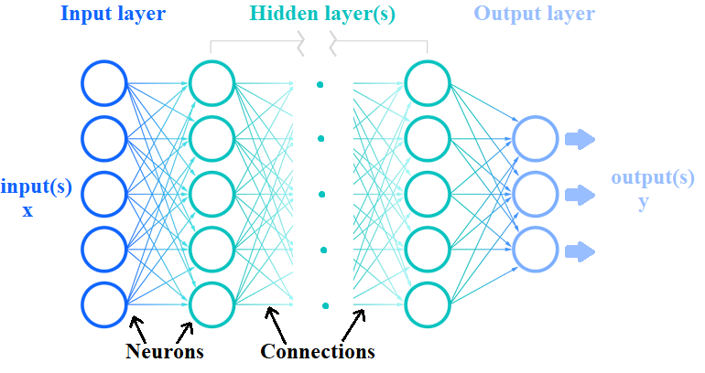
Neural networks: overview
Subset of machine learning, the heart of Deep learning algorithms
Able to recognize very complex patters (used for image, text and audio data)
Source: IBM

Slide 5
Neural networks: types
Types or different architectures of neural networks
Feedforward Neural Networks: Tabular datasets
Recurrent Neural Networks (RNN): Sequential data such as text or audio
Convolutional Neural Networks (CNN): Image and video processing
Transformers: Text, audio and image processing
Deep Learning is the use of models that have a neural network architecture with a huge amount of layers
Commonly the three types of architectures are combined into bigger models!

Slide 6
Feedforward neural networks
Each node has an associated weight, threshold, and activation function
If node output > threshold, neuron is “activated”, passes information to next layer
Source: IBM

Slide 7
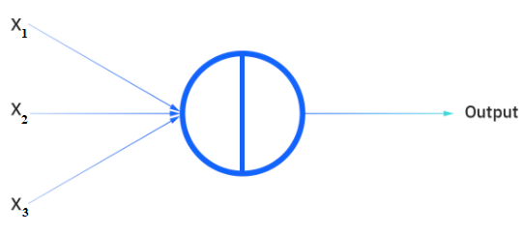
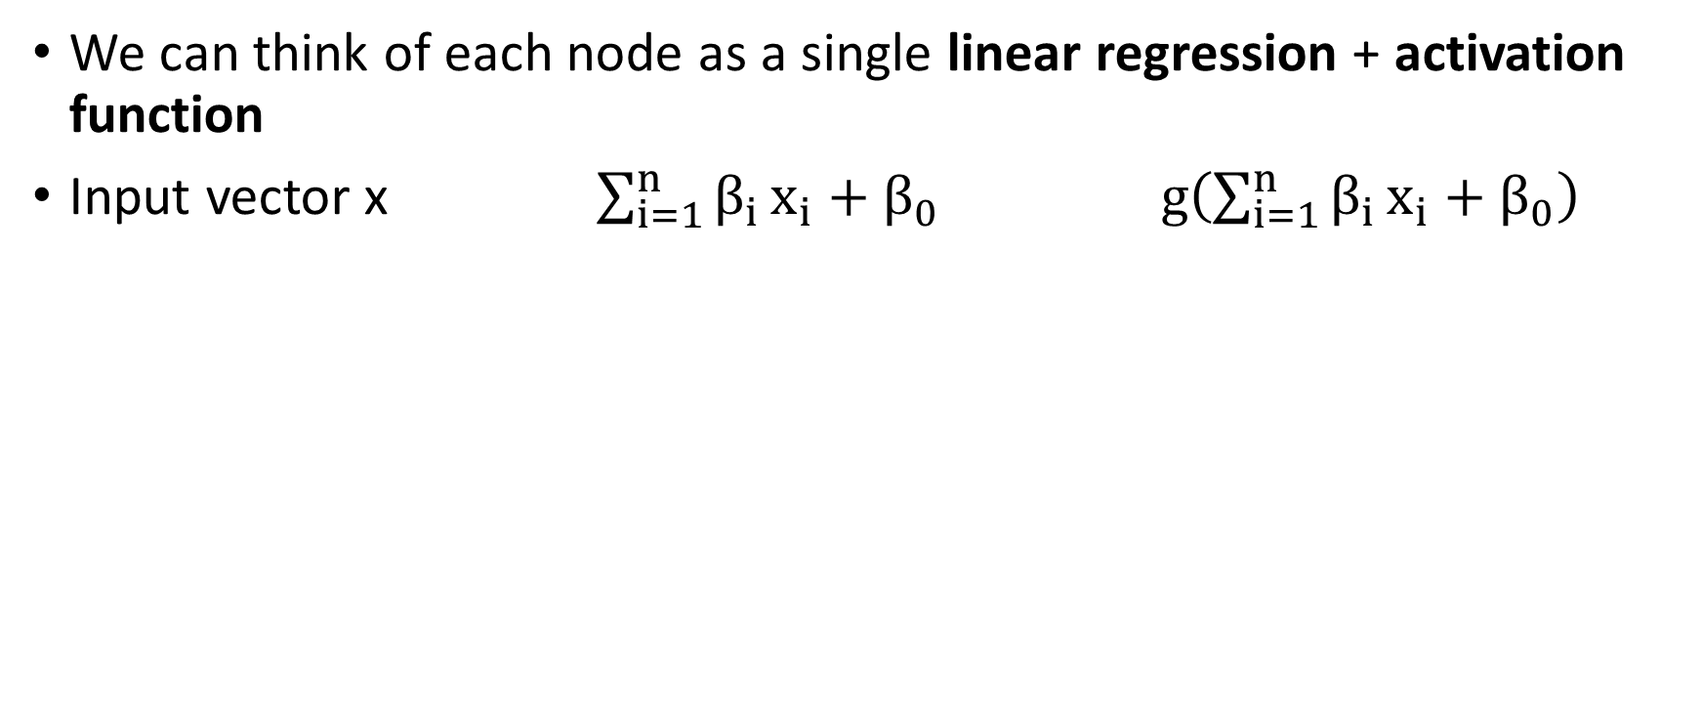

Feedforward neural networks
We can think of each node as a single linear regression + activation function
Input vector x $\sum_{i=1}^{n}{β_{i}}x_{i}+β_{0}$ $g\left(\sum_{i=1}^{n}{β_{i}}x_{i}+β_{0}\right)$
$$Σ$$
g
Source: IBM

Slide 8
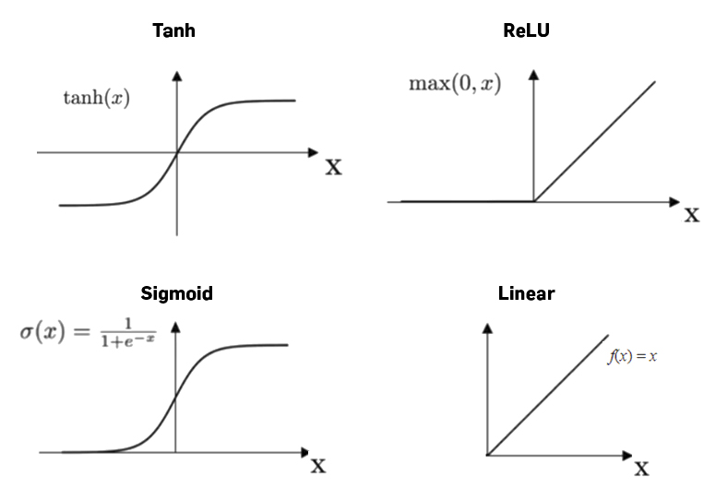
Types of activation functions
And many more…
active research topic!

Slide 9
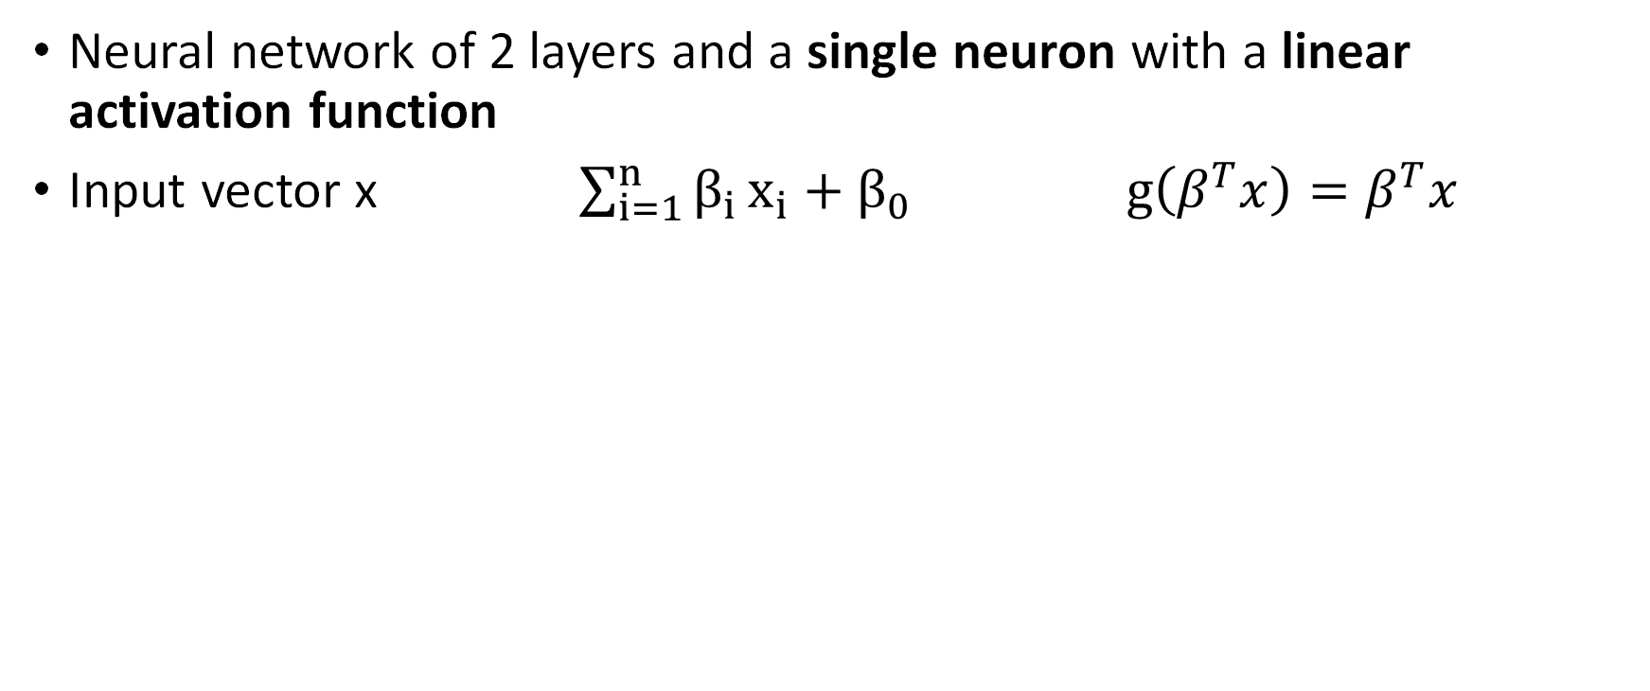

Linear regression as a neural network?
Neural network of 2 layers and a single neuron with a linear activation function
Input vector x $\sum_{i=1}^{n}{β_{i}}x_{i}+β_{0}$ $g\left(β^{T}x\right)=β^{T}x$
g = identity or linear activation function
$$Σ$$
$$σ$$
Source: IBM

Slide 10
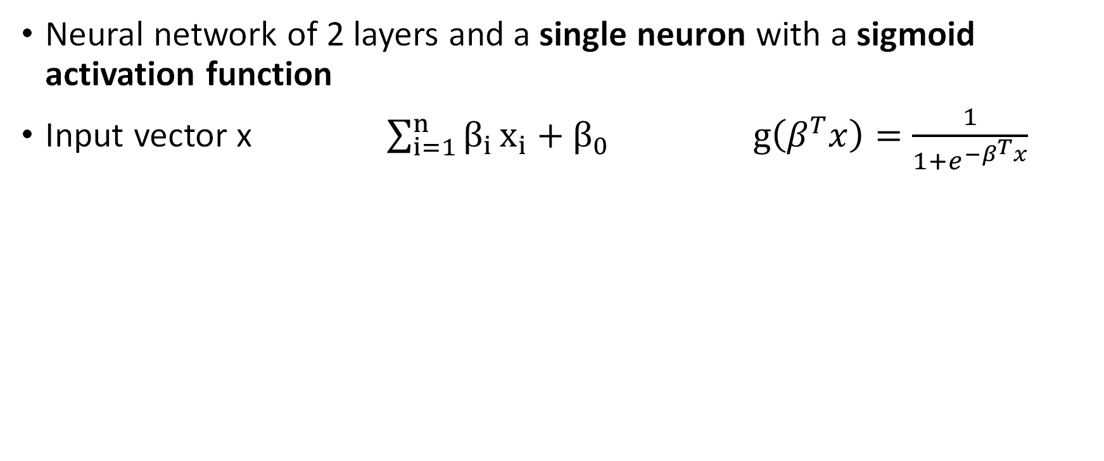
Feedforward NN: simple perceptron
Neural network of 2 layers and a single neuron with a sigmoid activation function
Input vector x $\sum_{i=1}^{n}{β_{i}}x_{i}+β_{0}$ $g\left(β^{T}x\right)=\frac{1}{1+e^{−β^{T}x}}$
g = sigmoidal or logistic function
$$Σ$$
$$σ$$
Source: IBM

Slide 11

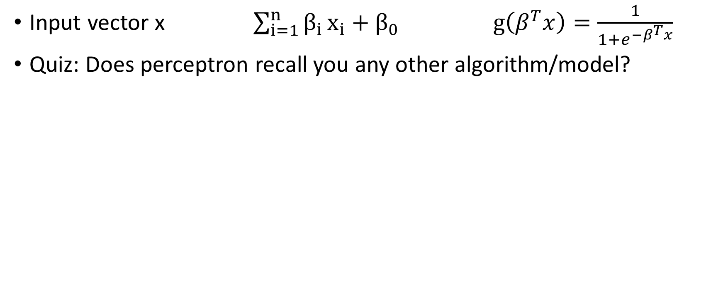
Feedforward NN: simple perceptron
Input vector x $\sum_{i=1}^{n}{β_{i}}x_{i}+β_{0}$ $g\left(β^{T}x\right)=\frac{1}{1+e^{−β^{T}x}}$
Quiz: Does perceptron recall you any other algorithm/model?

Slide 12
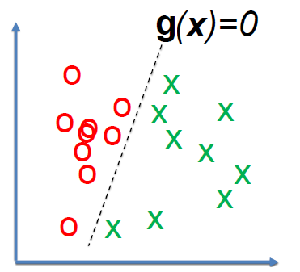
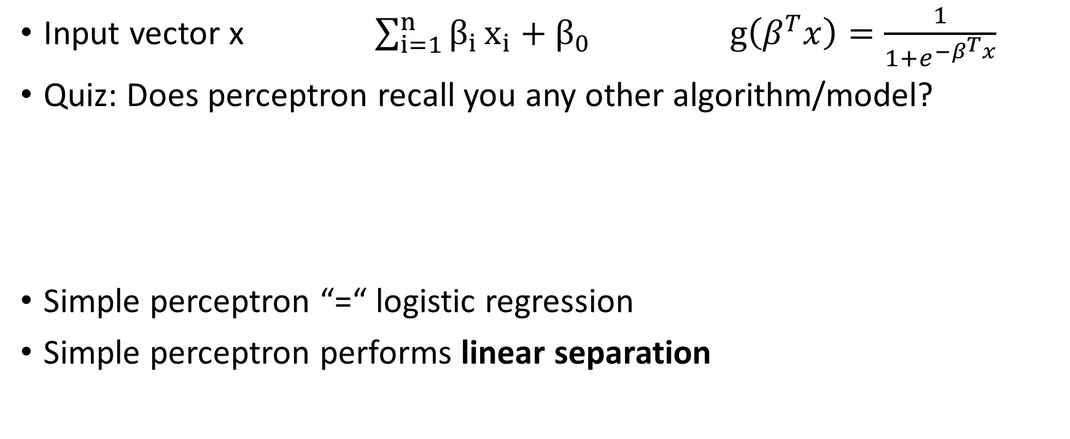
Feedforward NN: simple perceptron
Input vector x $\sum_{i=1}^{n}{β_{i}}x_{i}+β_{0}$ $g\left(β^{T}x\right)=\frac{1}{1+e^{−β^{T}x}}$
Quiz: Does perceptron recall you any other algorithm/model?
Simple perceptron “=“ logistic regression
Simple perceptron performs linear separation
Logistic regression

Slide 13
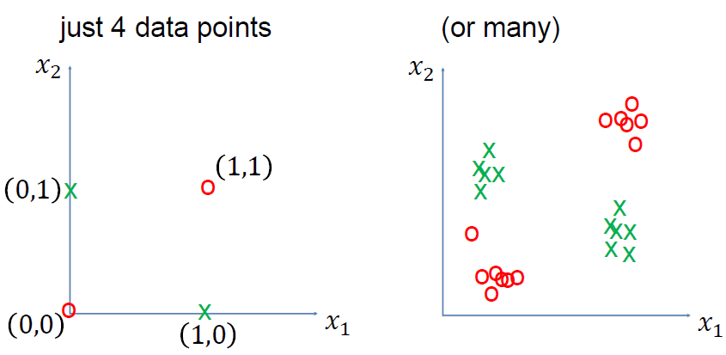
What about non-linear separable tasks?
Classical XOR problema, not linearly separable

Slide 14
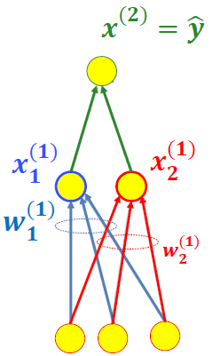
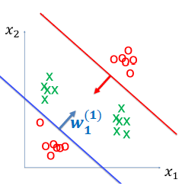
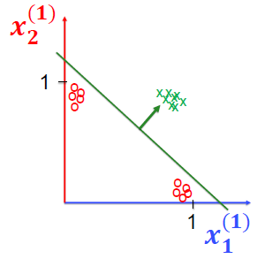
Solution: Add a second layer!
Second layer takes as input output of red and blue neurons
Two-layer network can solve a non-linear problem

Slide 15
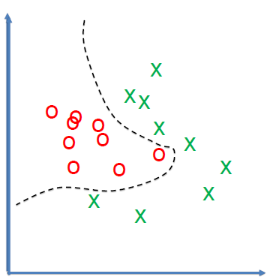
Feedforward NN: Multi Layer Perceptron (MLP)
Neural network with more than three layer and non-linear activation function
Very flexible, adapt to non-linear problems
Classification and regression tasks

Slide 16
Universal Approximation Theorem
A feedforward network with a single layer is sufficient to represent any function, but the layer may be infeasibly large and may fail to learn and generalize correctly.
Ian Goodfellow, Deep Learning
Big implication: a neural network can (in theory) solve any problem!

Slide 17
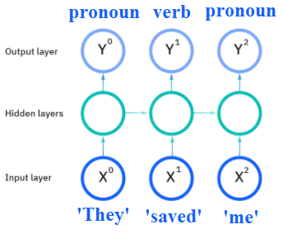
Recurrent Neural Networks: overview
Useful to work with sequence prediction problems
They have “memory”: take information from previous inputs to influence current input/output
Popular architectures:
LSTM (1997)
BRNN (1997)
GRUs (2014)

Slide 18
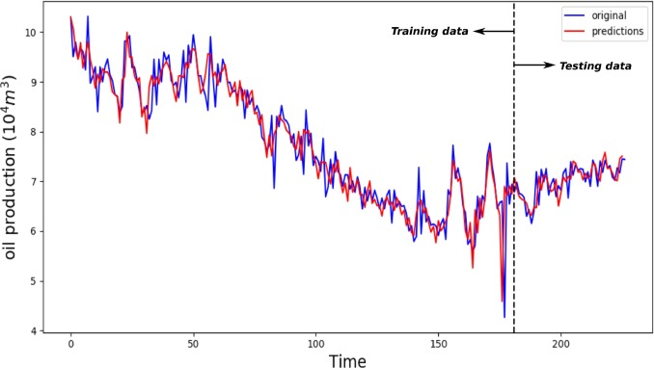
Recurrent Neural Networks: use cases
Time-series prediction: stocks, productivity, weather,….
Source: Sagheer et al, 2019

Slide 19

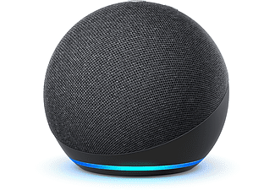
Recurrent Neural Networks: use cases
Voice detection: Siri(Apple), Alexa(Amazon), HeyGoogle(Google),…

Slide 20
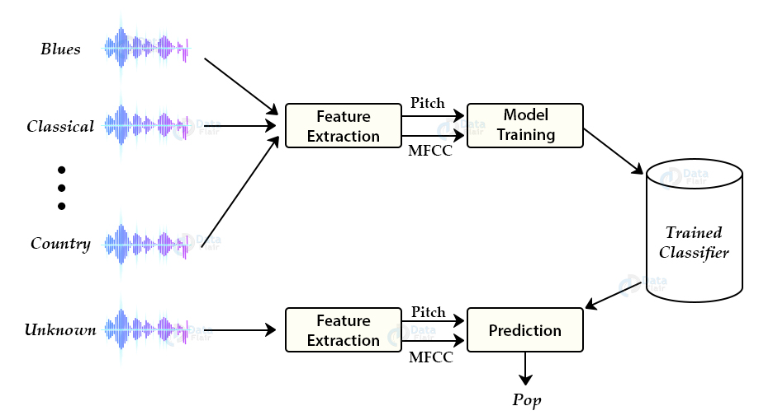
Recurrent Neural Networks: use cases
Music generation: predict next note given a sequence of previous notes
Music genre classifier
Jukebox, OpenAI 2020
Source: DataFlair

Slide 21
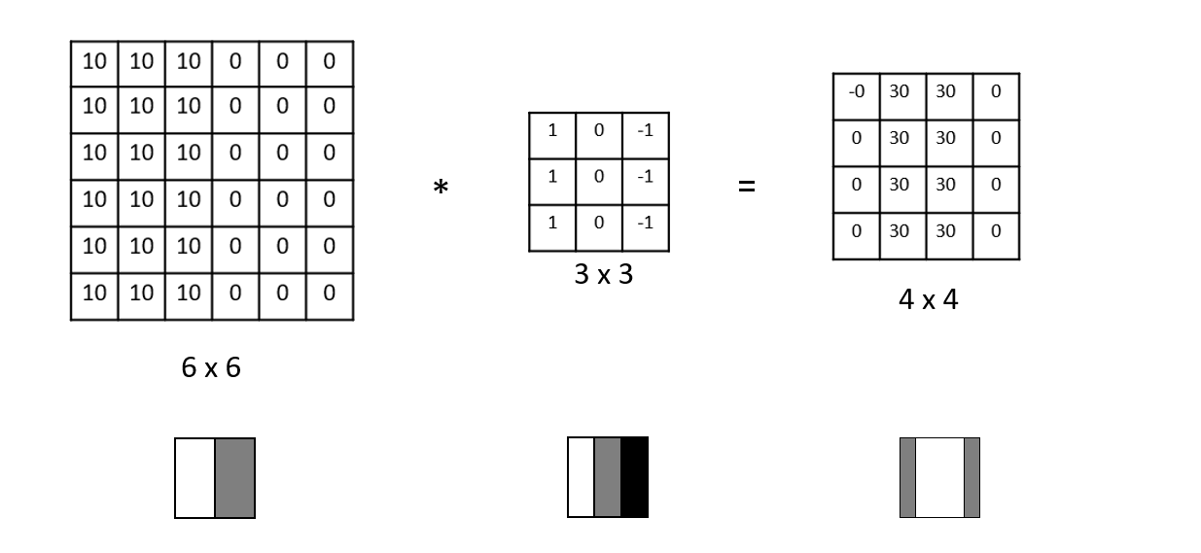
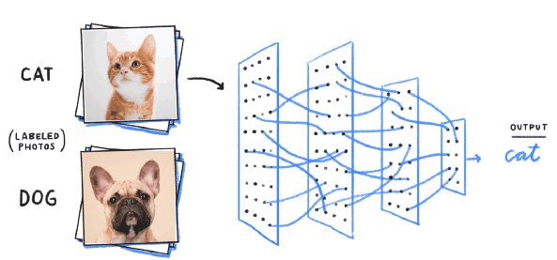
Convolutional Neural Networks: overview
They work really well for image data, they are designed to capture and learn the spatial structure of the data. “Computer Vision” tasks
Building blocks are filters or kernels that extract relevant features using the convolution operation
Source: datahacker
Source: analyticsvidhya

Slide 22
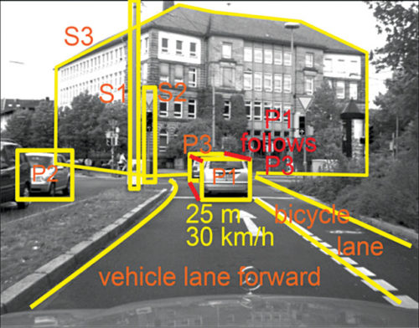
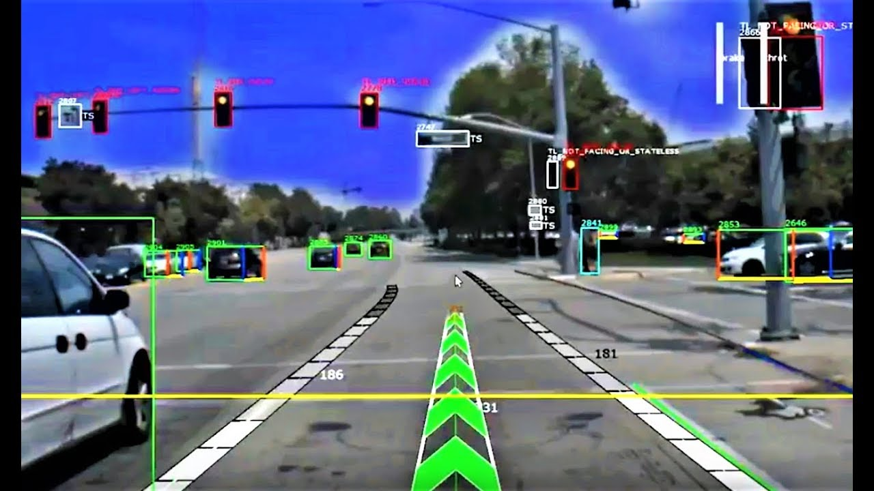
Convolutional Neural Networks: use cases
Object and Edge detection for autonomous driving
Source: V.P. Sampath
Source: Vecanoi

Slide 23
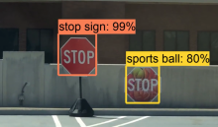

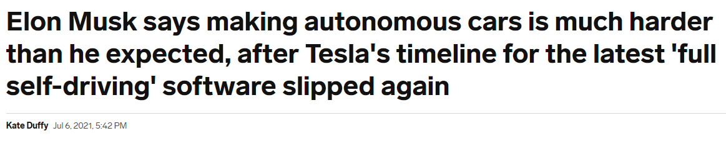
Convolutional Neural Networks: use cases
Autonomous driving, not an easy problema, still a long way ahead!
Source: GeorgiaTech

Slide 24
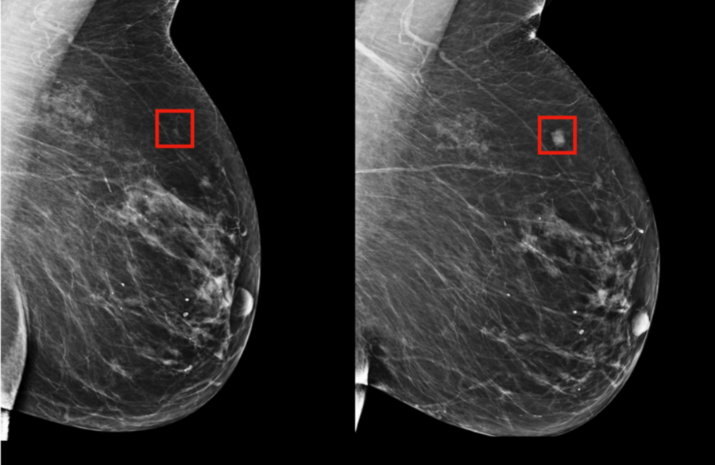

Convolutional Neural Networks: use cases
Several applications in healthcare: tumor detection, COVID-19 detection, …

Slide 25
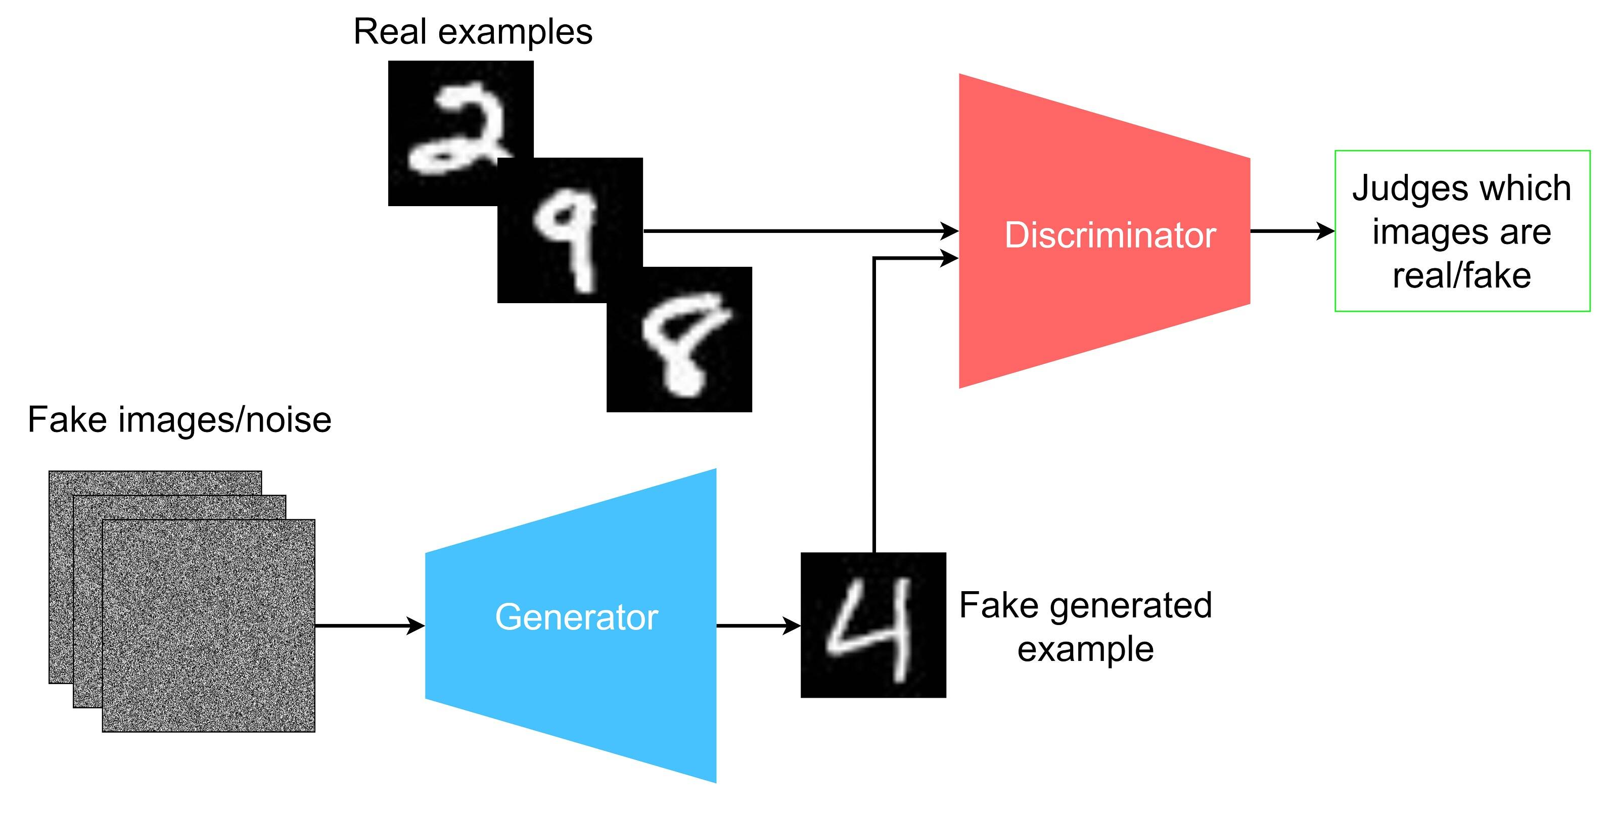
Aside: Generative Adversarial Netoworks (GANs)
Synthetic Image/audio/video generation.
Train a discriminator and generator modules.

Slide 26


GANs use cases
Art (music, painting, …) generation
Fashion (clothes, models, …) design

Slide 27

GANs risks
Deepfakes
Copyright issues
...

Slide 28
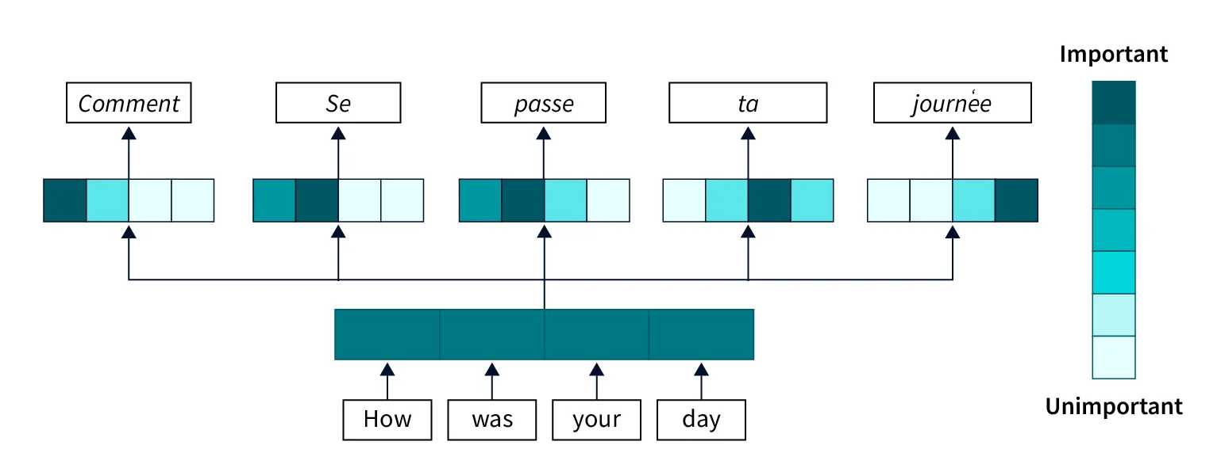
Transformers: overview
Most recent architecture! (Attention is all you need, Vaswani et al. 2017)
They work really well for natural language processing tasks (text processing, translation, ...).
Sentences are processed as a whole (attention) rather than word by word.

Slide 29
Transformers: use cases
Quiz: Do you know any popular model based on transformers?

Slide 30

Transformers: use cases
Quiz: Do you know any popular model based on transformers?

Slide 31

Transformers: use cases
Large Language Models (ChatGPT, GPT-4, …)
ChatGPT trained on massive amount of data + human feedback loop!

Slide 32

Transformers: use cases
LLM are very powerful and can be really useful, but they also bring risks!
Malicious bots
Fake information generation
Phishing emails
IP & data privacy issues
...

Slide 33
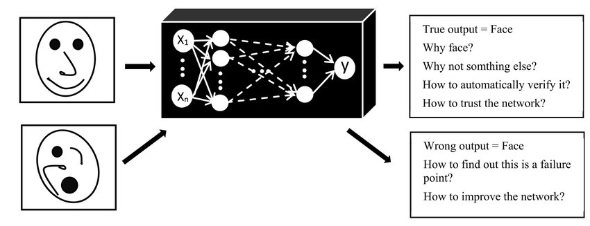
Deep Learning issues: interpretability
Deep Learning models are considered “Black box” models, it is hard to understand and analyse the decisions of the model!
Black box
Source: Plataniotis et al. 2018

Slide 34


Deep Learning: pros and cons
Pros:
Can execute really complex tasks, methods are flexible and adapt to different types of data
They can reach impressive performance
Cons:
They are black-box models, not interpretable!
Extremely expensive to train (computational cost is huge)
Requires large amount of data

Slide 35
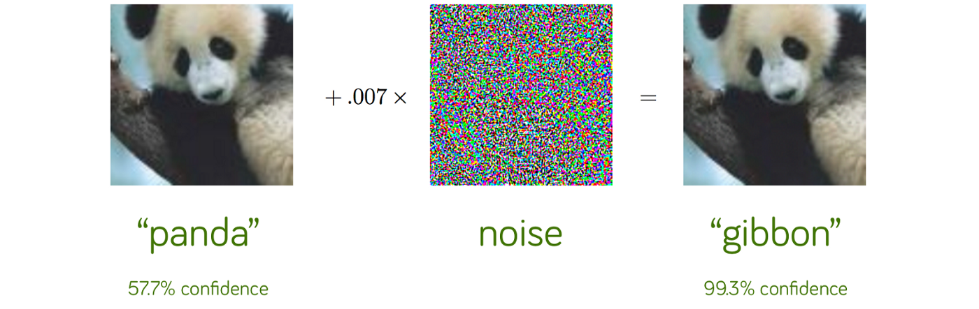
AI risks: adversarial attacks!
Imperceivable noise that tricks the Deep Learning model
Source: Explaining and Harnessing Adversarial Examples, Goodfellow et al, ICLR 2015.

Slide 36
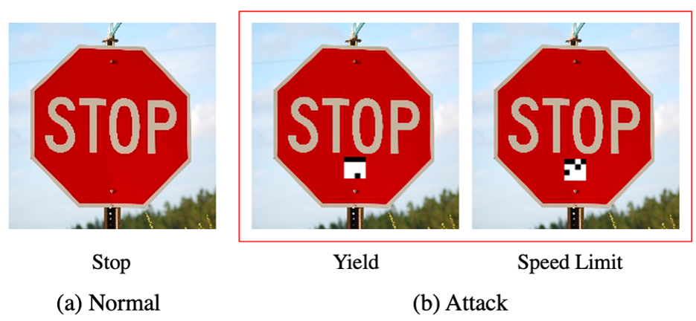
AI risks: adversarial attacks
Source: Ben Dickson – The Daily Swig

Slide 37
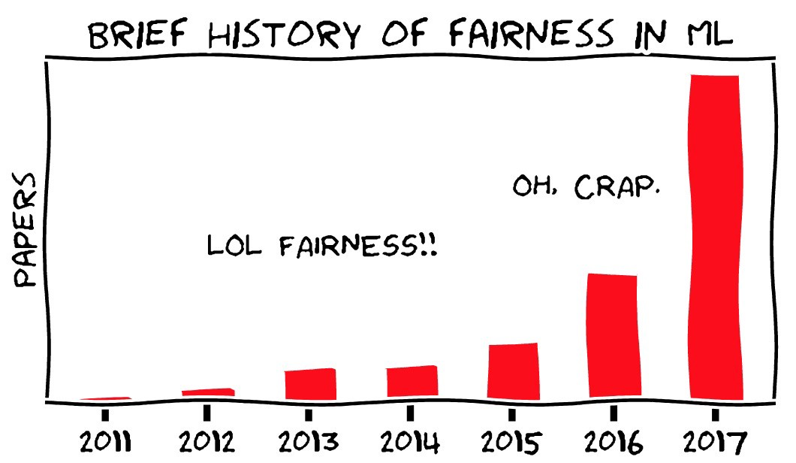
Ethical questions around AI
AI systems are increasingly present in high-stake decisión processes
Is our algorithm making fair decisions? Is discriminating by race or gender?...
Source: Ziyuan Zhong

Slide 38
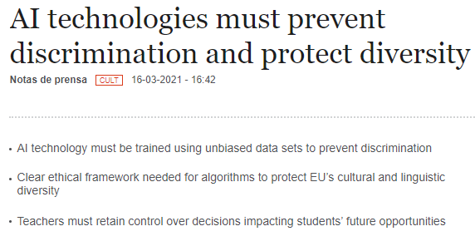
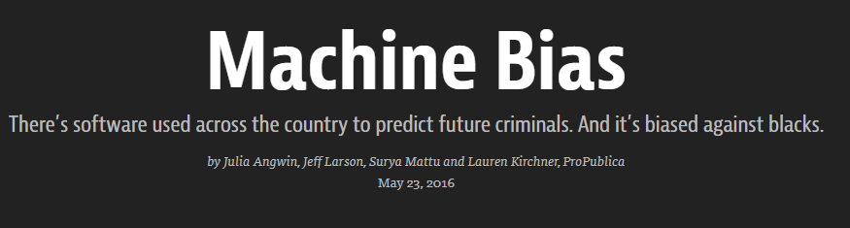

AI discrimination problem

Slide 39

AI discrimination problem

Slide 40
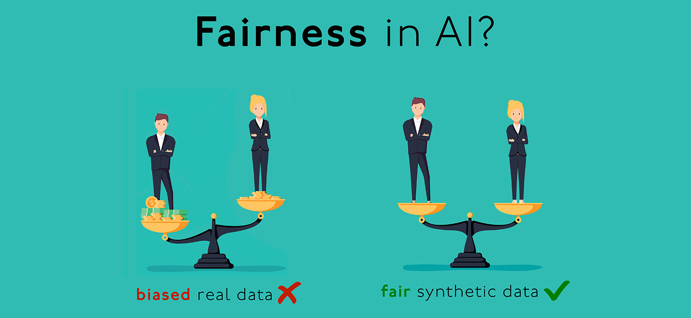
Real world data encodes discrimination
Historical data might encode systematic discriminatory biases present in our society, such as racial, gender, or sexual orientation bias.. If we train models on such data, we créate discriminative models
Source: Mostly AI

Slide 41
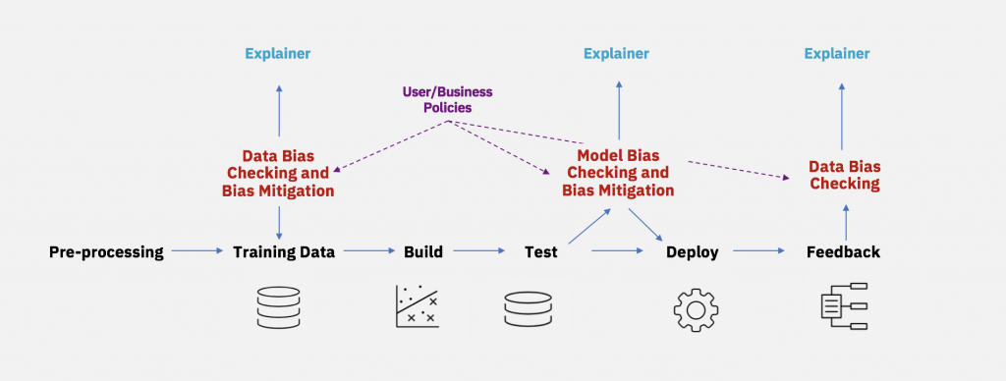
Ensuring AI fairness
We can mitigate data and model bias
Source: IBM

